Slide 1
Mini-intervention Model for Advancing Culture’s Role in Well-being
This model was developed in the Sustainable Growth Programme for Finland as part of the cross-sectoral service concept for welfare and health promotion in 2023–2025 under the direction of the City of Helsinki. You can find the model and its additional materials on the Innokylä website (in Finnish).

Slide 2

Three questions to bring up creativity, cultural activities and art
1. What kinds of creativity, cultural activities or art are part of your life now or were part of your life in the past?
Examples of creativity, art and cultural activities:
listening to music, doing crafts, reading, drawing, writing, watching movies, enjoying nature, going to concerts, gigs, theatre performances, museums or sports events.
Engaging in culture includes all this and other meaningful activities in everyday life.
What is meaningful and brings joy to you?

Slide 3

Three questions to bring up creativity, cultural activities and art
2. What kinds of thoughts, feelings or sensations do creativity, cultural activities and art evoke in you?
Can you recognise the small moments in your everyday life where taking a break to enjoy art or creativity has helped you feel happy or relaxed on a busy day?
For example, does music bring you comfort when you are sad, or do you put on your favourite song and dance in moments of joy?
Do crafts help you to stop and enjoy the moment?
Do movies make you laugh?
Is there something — a fear, a thought, or a feeling — that stops or hinders you from expressing your creativity?

Slide 4
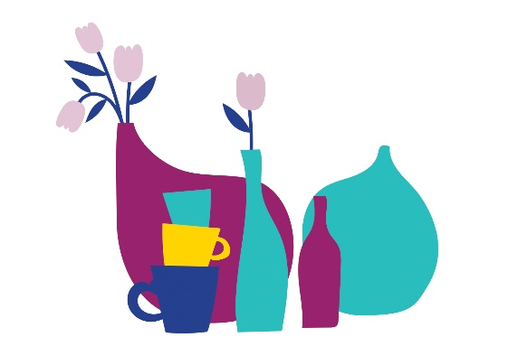
Three questions to bring up creativity, cultural activities and art
3. If you wanted to add more creativity, cultural activities and art to your life, what would it be?
If you tried something new, what would it be?
What would help you to try it?
How, where, and when would you try it?

Slide 5
“How you can talk about creativity, cultural activities and art as supporters of everyday well-being?”
1. What kinds of creativity, cultural activities or art are part of your life now or were part of your life in the past?
This question helps the client reflect on all the creative activities that are or have been a part of their life. The concept of culture is broad, and you can explore together what it means to the client.
Think back and reflect on how creativity, cultural activities and art have been present in the different stages of the client's life.
Helping the client identify what already works — what they are capable of, know, and enjoy — can strengthen their sense of ability.
Identifying the creativity, cultural activities and art that are already a part of the client's life increases and strengthens the existing good things and supports their motivation to change.

Slide 6
“How you can talk about creativity, cultural activities and art as supporters of everyday well-being?”
2. What kinds of thoughts, feelings or sensations do creativity, cultural activities and art evoke in you?
This question deepens your understanding of the client’s situation and helps them reflect on what creativity, cultural activities and art mean to them.
It can also help explore the client’s personal resources as well as joys, fears, concerns, barriers and beliefs that may affect their participation.
Together, you can identify which benefits are the most important to the client; change is more likely if the goal is to achieve things that are important to the client.
You can learn more about the proven benefits of cultural activities, creativity and the arts to well-being on the Taikusydän website.

Slide 7
“How you can talk about creativity, cultural activities and art as supporters of everyday well-being?”
3. If you wanted to add more creativity, cultural activities and art to your life, what would it be?
This question helps the client find things that are meaningful to them and ways to bring more creativity, art and culture into their everyday life.
Discuss what the client enjoys doing and what feels important to them. It’s easiest to start with things the client already does or likes.
Self-sufficiency, a sense of capability and internal motivation help create new habits and lasting lifestyles.
When thinking about the future, 'trying something' can feel easier than 'setting a goal'. Trying something can mean doing more of the everyday creative, cultural or artistic activities that the client is already doing or used to do, or it can mean trying something completely new.
If a new activity doesn’t feel like it’s really your thing, it doesn’t mean it was a failure but an opportunity to try something else.

